Slide 1
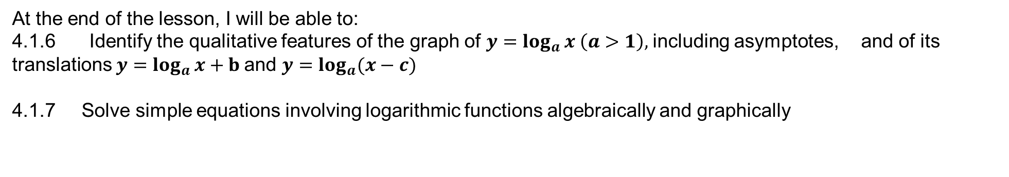
Learning Objective
I will be able to graph logarithmic functions and solve logarithmic functions graphically.
Success Criteria
At the end of the lesson, I will be able to:
4.1.6 Identify the qualitative features of the graph of $y=\log_{a}{x}$ $\left(a>1\right),$including asymptotes, and of its translations $y=\log_{a}{x}+b$and $y=\log_{a}{(x−c)}$
4.1.7 Solve simple equations involving logarithmic functions algebraically and graphically

Slide 2
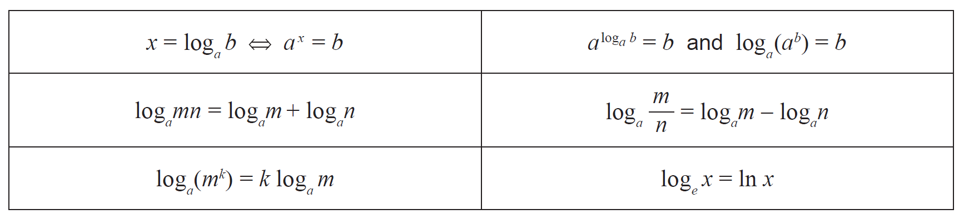




Laws of logarithm
In the formula sheet:
Inverse relationship between log and exponentials:
Law 7:
Law 1:
Law 2:
Natural logarithm:
Law 3:
Not in formula sheet:
Law 4: $\log_{a}{a=1}$
Law 5: $\log_{a}{1=0}$
Law 6: $\log_{a}{\frac{1}{x}}=−\log_{a}{x}$
Change of Base: $\log_{a}{b}=\frac{\log_{c}{b}}{\log_{c}{a}}$

Slide 3
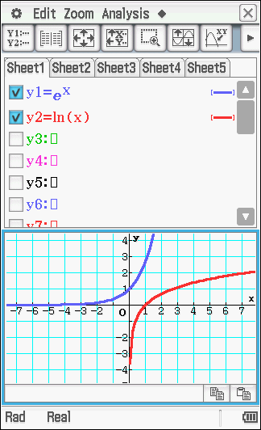
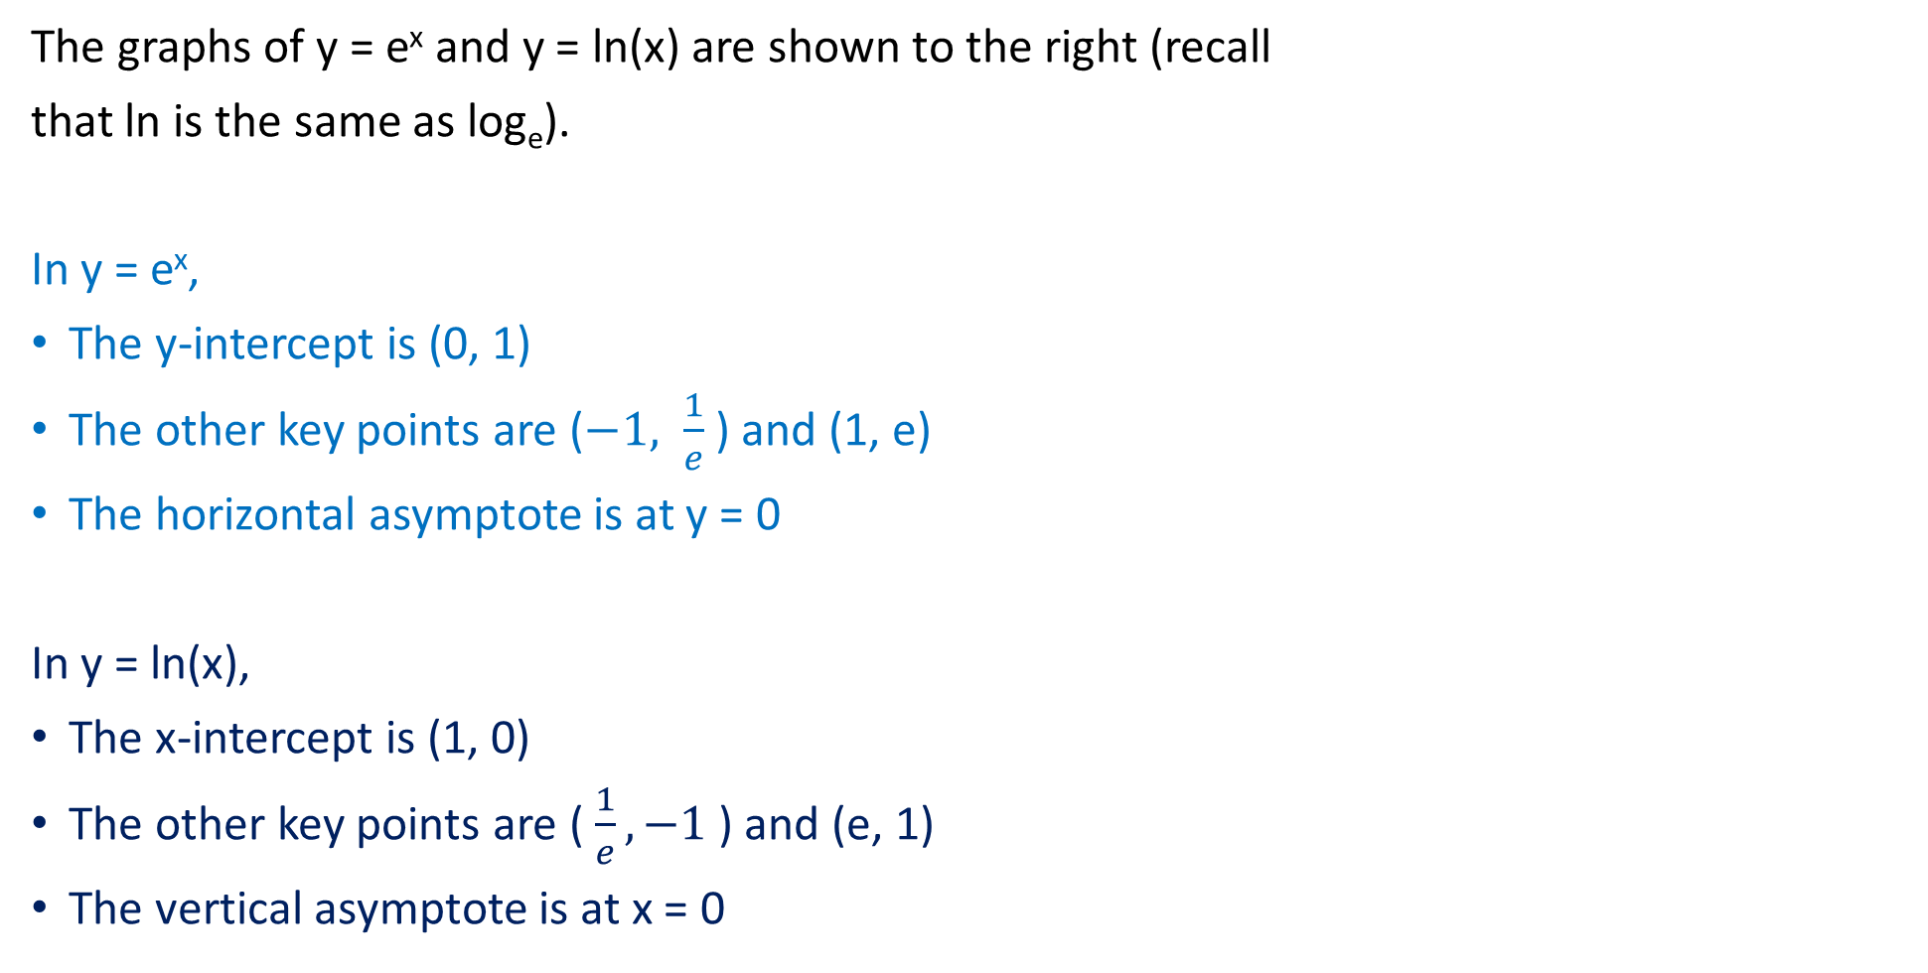

The Graphs of $e^{x}$ and $ln x$
The graphs of y = e^{x} and y = ln(x) are shown to the right (recall
that ln is the same as log_{e}).
In y = e^{x},
The y-intercept is (0, 1)
The other key points are ($−1, \frac{1}{e}$) and (1, e)
The horizontal asymptote is at y = 0
In y = ln(x),
The x-intercept is (1, 0)
The other key points are ($\frac{1}{e}, −1$ ) and (e, 1)
The vertical asymptote is at x = 0

Slide 4
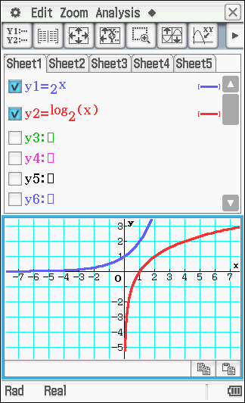
The Graphs of Logarithms with Different Bases
The graphs of y = 2^{x} and y = log₂(x) are shown to the right.
In y = 2^{x}
The y-intercept is (0, 1)
The other key points are (-1, ½) and (1, 2)
The horizontal asymptote is at y = 0
In y = log₂(x)
The x-intercept is (1, 0)
The other key points are (½, -1) and (2, 1)
The vertical asymptote is at x = 0

Slide 5
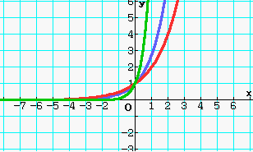
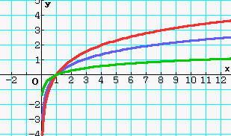
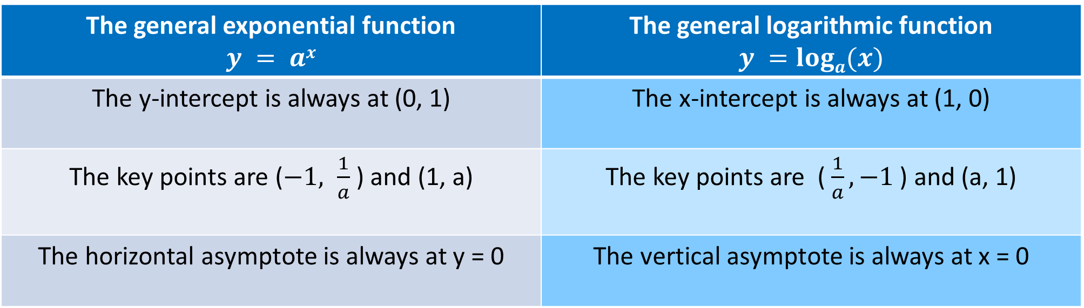
The general exponential function $$y = ax$$ | The general logarithmic function $$y =loga(x)$$
The y-intercept is always at (0, 1) | The x-intercept is always at (1, 0)
The key points are ($−1, \frac{1}{a}$) and (1, a) | The key points are ($\frac{1}{a}, −1$ ) and (a, 1)
The horizontal asymptote is always at y = 0 | The vertical asymptote is always at x = 0

Slide 6

Guided Practice
Determine the coordinates of the point where the graph $y=log_{2}(x+8)$ cuts the x-axis and y-axis.
x-intercept of $\log_{a}{(x)}$ is (1, 0)
x-intercept of $\log_{2}{(x+8)}$ is $\left(1,0\right)⇒(1−8, 0)=(−7,0)$
y-intercept: substitute $x=0$, $y=\log_{2}{(0+8)}$
$$y=\log_{2}{(8)} \\ y=\log_{2}{(2^{3})} \\ y=3$$ $y−intercept: (0,3)$

Slide 7

Guided Practice
Determine the coordinates of the point where the graph $y=log_{a}(x)$ cuts the line y=1
$$1=\log_{a}{(x)}$$
$$a^{1}=x$$
$$x=a$$
$Coordinates: \left(a,1\right), where a≥0$

Slide 8


Guided Practice
The graph below shows $y=\log_{a}{x}$, $y=\log_{a}{(x−b)}$ and $y=\log_{a}{x}+c$. Determine the values of $a$, $b$ and $c$ given that they are all positive integers.
The graph with the x-intercept (1, 0) must be
$$y = logax$$
Since the graph also has the point (2, 1):
$\log_{a}{(2)}$= 1
$a$¹ = 2
$∴$ $a$ = 2
The equation y = $\log_{a}{(x−b)}$ indicates a translation to the right by b units.
The graph with the x-intercept (5, 0) is the only graph that has translated to the right.
$$∴b=4$$
The remaining graph represents $y=\log_{a}{x}+c$
There is a translation up by 3.
$∴$c = 3 since the point (1, 0) has translated up by 3.

Slide 9







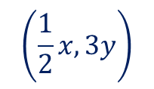



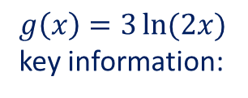

Guided Practice
Sketch the graph $y=3 ln(2x)$
Consider $f\left(x\right)=\ln{(x)}$
$g\left(x\right)=3\ln{(2x)}$
key information:
Key information:
Asymptote: $x=0$
Asymptote: $x=0$
X-intercept: $(1,0)$
X-intercept: $(\frac{1}{2},0)$
Key-points: $\left(e,1\right), \left(\frac{1}{e},−1\right)$
key-points: $\left(\frac{e}{2},3\right), \left(\frac{1}{2e},−3\right)$
$$g\left(x\right)=3\ln{(2x)}$$
$$=3f(2x)$$
Transformations that occur:
- Dilation parallel to the x-axis by a scale factor of $\frac{1}{2}$
- Dilation parallel to the y-axis by a scale factor of $3$
$$\left(\frac{1}{2}x,3y\right)$$
$$\left(x,y\right)→$$

Slide 10

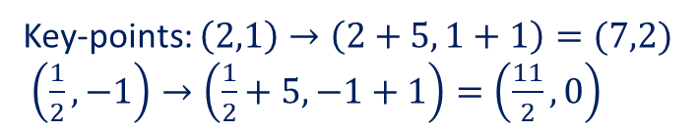








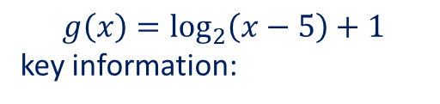
Guided Practice
Sketch the graph and state the natural domain of $y=log_{2}\left(x−5\right)+1$
Consider $f\left(x\right)=\log_{2}{x}$
$$g\left(x\right)=\log_{2}\left(x−5\right)+1$$
key information:
Key information:
Asymptote: $x=0$
Asymptote: $x=5$
X-intercept: $(1,0)$
X-intercept: $\left(1,0\right)→\left(1+5,1\right)=(6,1)$
Key-points: $\left(2,1\right), (\frac{1}{2},−1)$
Key-points: $\left(2,1\right)→\left(2+5, 1+1\right)=(7,2)$
$\left(\frac{1}{2},−1\right)→\left(\frac{1}{2}+5, −1+1\right)=\left(\frac{11}{2}, 0\right)$
$$g\left(x\right)=\log_{2}\left(x−5\right)+1$$
$$=f\left(x−5\right)+1$$
Transformations that occur:
- Translate to right along the x-axis by $5$ units
- Translates vertically up along the y-axis by $1$ unit
$$\left(x,y\right)→$$
$$\left(x+5,y+1\right)$$
Natural Domain: $\left\{x∈ℝ, x>5\right\}$

Slide 11






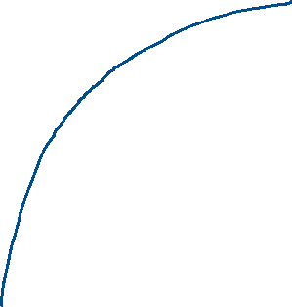


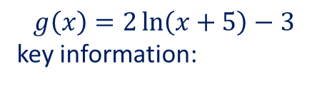


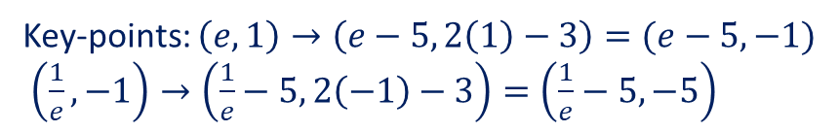






Guided Practice
Sketch the graph and state the natural domain of $y=2ln\left(x+5\right)−3$
Consider $f\left(x\right)=\ln{(x)}$
$$g\left(x\right)=2\ln\left(x+5\right)−3$$
key information:
Key information:
Asymptote: $x=0$
Asymptote: $x=−5$
X-intercept: $(1,0)$
$\left(1,0\right)→\left(1−5,2\left(0\right)−3\right)=(−4,−3)$
Key-points: $\left(e,1\right), \left(\frac{1}{e},−1\right)$
Key-points: $\left(e,1\right)→\left(e−5, 2\left(1\right)−3\right)=(e−5,−1)$
$\left(\frac{1}{e},−1\right)→\left(\frac{1}{e}−5, 2\left(−1\right)−3\right)=\left(\frac{1}{e}−5,−5\right)$
$$g\left(x\right)=2\ln\left(x+5\right)−3$$
$$=2f\left(x+5\right)−3$$
y-intercept: $(0,2\ln{5}−3)$
Transformations that occur:
x-intercept: $(e^{\frac{3}{2}}−5,0)$
- Translate to left along the x-axis by $5$ units
- Dilation parallel to the y-axis by a scale factor of $2$
- Translates vertically down along the y-axis by $3$ unit
$$\left(x,y\right)→$$
$$\left(x−5, 2y−3\right)$$
Natural Domain: $\left\{x∈ℝ, x>−5\right\}$

Slide 12
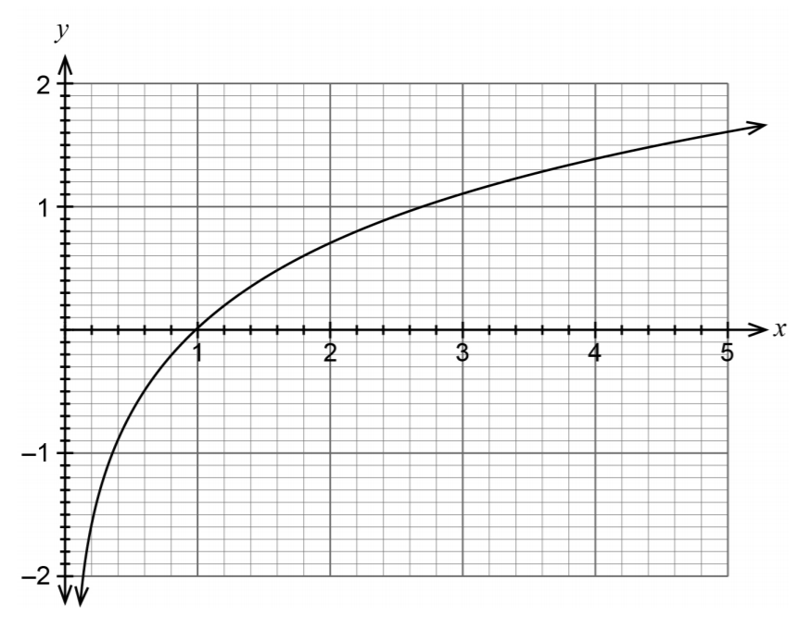

Guided Practice: WACE 2019 Calc Free
Consider the graph of $y=ln x$ shown below:
Use the graph to estimate the value of $p$ for the following:
i. $1.4=ln p$
ii. $e^{p+1}−3=0$

Slide 13

Guided Practice: WACE 2019 Calc Free
Use the graph to estimate the value of $p$ for the following:
i. $1.4=ln p$
$p≈4$ from the graph
ii. $e^{p+1}−3=0$
$e^{p+1}=3$
$p+1=ln 3$
$p=ln 3−1$
Note: $ln 3$ from the graph is approximately 1.1
$∴p≈0.1$

Slide 14

Guided Practice: WACE 2019 Calc Free
Consider the graph of $y=ln x$ shown below:
b) Sketch the graph of $y=ln\left(x−2\right)+1$

Slide 15
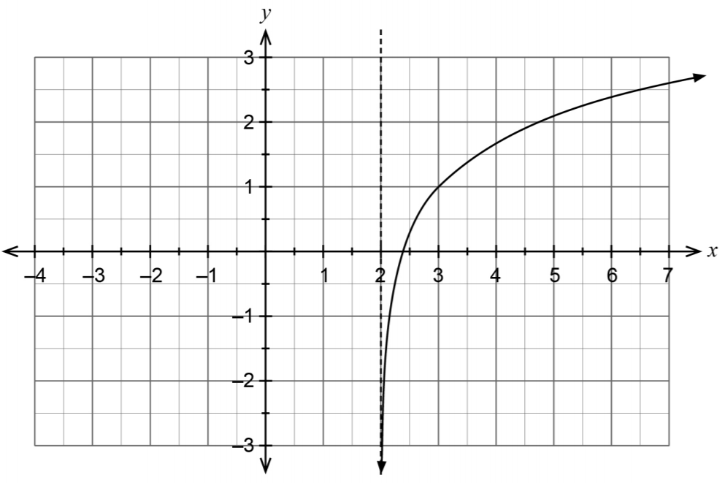
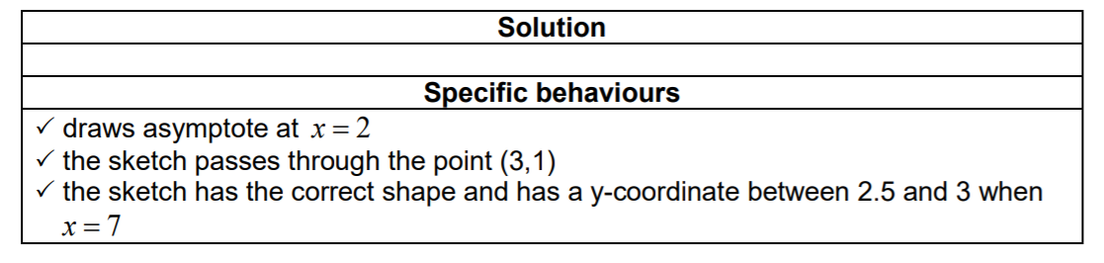

Guided Practice: WACE 2019 Calc Free
b) Sketch the graph of $y=ln\left(x−2\right)+1$

Slide 16
Guided Practice
The curve y = log_{e}(x) is reflected parallel about the y-axis, then translated 1 unit in the positive direction of the x-axis and 2 units in the positive y-direction.
Write the equation that results from these transformations.
Original equation y = log_{e}(x)
Reflection parallel to y-axis y = log_{e}(-x)
Translated 1 unit in +ve x-axis y = log_{e}(-(x – 1))
Translated 2 units in +ve y-axis y = log_{e}(-(x – 1)) + 2
Hence the new equation is y = log_{e}(-(x – 1)) + 2

Slide 17
Guided Practice
Determine the transformations applied to the basic graph of y = log_{e}(x) to achieve the resulting equation y = 2 – 6log_{e}(5 – x)
Original equation y = log_{e}(x)
New equation y = 2 – 6log_{e}(5 – x)
y = -6log_{e}(-(x – 5)) + 2
The function has been
dilated by a scale factor of 6 parallel to the y-axis.
reflected about the y-axis and the x-axis.
Translated 5 units to the right towards the positive direction of the x-axis.
Translated upwards by 2 units along the positive y-axis.

Slide 18

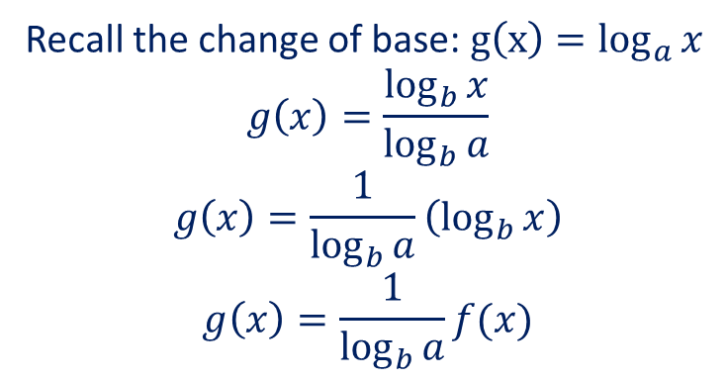


Graphs with Different Bases
Given the graph of $f\left(x\right)=\log_{b}{x}$. Consider how the graph is transformed to $g(x)=\log_{a}{x}$
Recall the change of base: $g\left(x\right)=\log_{a}{x}$
$$g\left(x\right)=\frac{\log_{b}{x}}{\log_{b}{a}}$$
$$g\left(x\right)=\frac{1}{\log_{b}{a}}\left(\log_{b}{x}\right)$$
$$g\left(x\right)=\frac{1}{\log_{b}{a}}f(x)$$
$f(x)$ is dilated by a scale factor of $\frac{1}{\log_{b}{a}}$ parallel to the y-axis
Given the graph of $f\left(x\right)=b^{x}$. Consider how the graph is transformed to $g(x)=a^{x}$
We want to change the base of $g(x)$ from $a$ to $b$
Applying law 7, $a^{\log_{a}{b}}=b$
We can rewrite $a=b^{\log_{b}{a}}$
Subst $a=b^{\log_{b}{a}}, g\left(x\right)=b^{(\log_{b}{a})x}=f\left((\log_{b}{a}\right)x)$
$f(x)$ is dilated by a scale factor of $\frac{1}{\log_{b}{a}}$ parallel to the x-axis

Slide 19




Guided Practice
Find a transformation that takes the graph of $y=2^{x}$ to the graph of $y=e^{x}$
$f\left(x\right)=2^{x}, g\left(x\right)=e^{x}$
$$e=2^{\log_{2}{e}}$$
$g\left(x\right)=2^{(\log_{2}{e})x}$
$$=f\left(\left(\log_{2}{e}\right)x\right)$$
The graph of$y=2^{x}$ is being dilated parallel to the x-axis by a scale factor of $\frac{1}{\log_{2}{e}}$

Slide 20
Independent Practice
Complete Ex 2E

